Slide 1
Lab session 10. AVL
Kamil Salakhiev

Slide 2
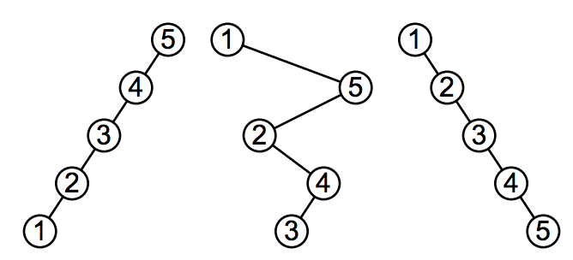
Why balance?

Slide 3
Height Balanced Tree.
If T is non-empty binary tree with left and right sub-trees T_1 and T_2
T is balanced if and only if
T_1 and T_2 are balanced, and
|height(T_1) - height(T_2)| <= 1

Slide 4
Balance factor
The difference between heights of right and left subtrees is called balance factor:
Bfactor(T) = height(T_2) – height(T_1)
What are the possible bfactor values in balanced tree?

Slide 5
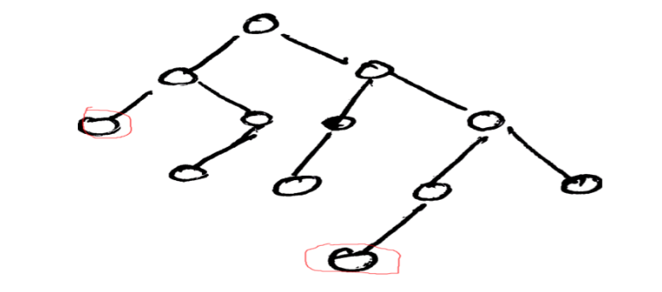
AVL. Example

Slide 6
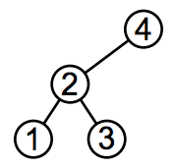
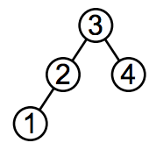
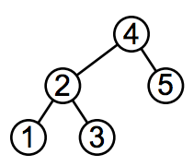
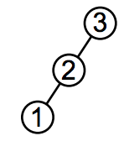
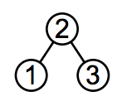
Exercise!
Determine which of given trees are not balanced

Slide 7
AVL tree
Binary tree + balancing

Slide 8
Additional methods
private class Node { Key key; Value val; Node left, right; int N; int height; … }

Slide 9
Additional methods
private int height(Node root){ return root != null ? root.height : 0; }

Slide 10
Additional methods
private void fixHeight(Node root){ int hl = height(root.left); int hr = height(root.right); root.height = (hl > hr ? hl : hr) + 1; }

Slide 11
Additional methods
private int bfactor(Node root){ return height(root.right) - height(root.left); }

Slide 12
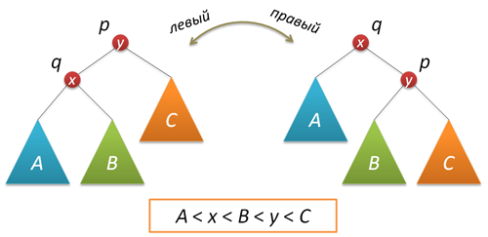
Additional methods
private Node rotateLeft(Node q){ Node p = q.right; q.right = p.left; p.left = q; fixHeight(q); fixHeight(p); return p; }

Slide 13
Additional methods
private Node rotateRight(Node p){ Node q = p.left; p.left = q.right; q.right = p; fixHeight(p); fixHeight(q); return q; }

Slide 14
Exercise!
Perform right rotation around node 2 and 4

Slide 15
Balancing
How to detect such situation applying balance factor?

Slide 16
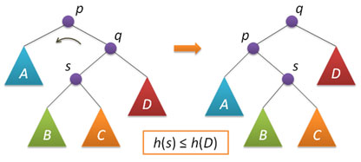
Balancing
How to detect such situation applying balance factor?

Slide 17
How to implement it in Java?

Slide 18
AVL operations
Insertion – same as in binary tree ?
Delete ?

Slide 19
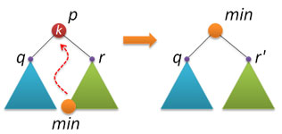
Delete
Remove. Root is now the leftmost from the right
What is right sub-tree doesn’t exist ?

Slide 20
Task for today
1) Implement rotation methods in their class. Carefully add balancing operation to insert and delete implementations. Test your tree on with the following actions:
insertion sequence: March, May, November, August, April, January, December, July, February, June, October, September.
deletion sequence: April, August, December.
find sequence: January-December (all months present except deleted).

Slide 21
Bonus task. Hand In
2) (*) Measure algorithm complexity properties.
Insert 1000000 (1M) values from 0 to 999999 into the tree.
For each insertion, measure operation time and tree height.
Delete elements from 0 to 999999.
For each deletion, measure operation time and tree height.
Build 2 graphs that show operation time and tree height depending on number of
elements in a tree. Do they fit O(log n) estimation?

Slide 22
To make life easier you can go to the link
http://habrahabr.ru/post/150732/

